Slide 1
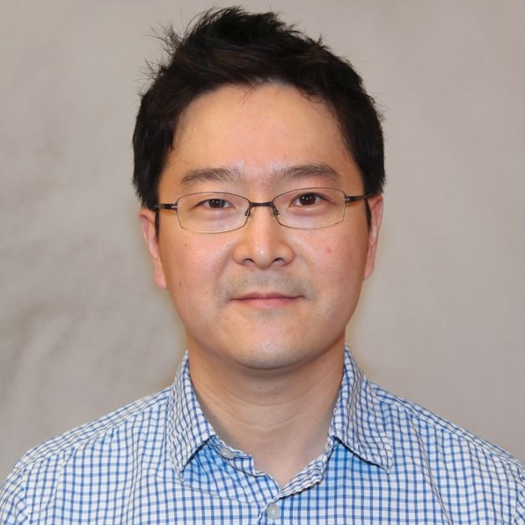
Hoyong Chung
Chemical and Biomedical Engineering
hchung@fsu.edu
My research group synthesizes new polymers for biomedical applications. A target polymer is a medical adhesive. The adhesive can be used in hard/soft tissue adhesive, localized drug delivery, hemostasis and so forth. We can control the adhesion property and mechanical strength of the polymer for different applications. Also the bearing drug can be released in a controlled manner by external stimulus.
I am interested in medical adhesives, local drug delivery, and medical patches.
New polymer, Adhesive, Fillers.

